Slide 1
Towards a Fair State Pension for Women Pensioners
Age Action-2017
Maureen Bassett, MSc. Researcher and Social Policy Analyst (February 2017)

Slide 2
Overview of Presentation
Introduction
Policy Context
2012 Band changes
Case studies and Interviews
Recommendations

Slide 3
Aim and Objectives of the Study
The Aim :
To investigate the extent and impact of 2012 band changes in the State Pension Contributory system on women pensioners and to propose (and cost) remedies.
The Objectives:
• To set the context for the research by reviewing existing literature on the Irish State Pension system;
• To analyse and present data on the operation of the Irish State Pension;
• To carry out interviews with relevant key stakeholders:
• To ensure the voice of pensioners affected is represented by profiling case studies of individuals:
• To identify and cost solutions that would reverse the impact of these changes on the pensioners affected.

Slide 4
Methodology
Literature and documentary review
Semi structured interviews with:
  people directly affected (4)
  people not directly affected but with relevant issues related to the state pension-male with atypical employment and female affected by cut-off year in the Homemakers Scheme
  other key stakeholders (5) including: leader of national research organisation; senior researcher and academic; leader in pension policy; DSP official working on pension policy and implementation; activist and advocate in women’s and older people’s equality.

Slide 5
Policy Context

Slide 6
Ireland and Welfare State Regimes
Corporatist; Liberal and Social Democratic ( Esping Andersen);
Ireland as Corporatist: reliance on family, religious and charitable organisations and bodies such as trade unions to provide welfare services (albeit often with state support);
Move to liberal model with greater emphasis on the individual with associated risks and privatisation of services.
Relevance to study:
No universal pension;
No or weak child care provision;
Increasing emphasis on pillars two and three (private and occupational pensions) where the risk lies with the individual.

Slide 7
Gender Regimes
Underestimated the gendered nature of welfare states
Lack of recognition of role of women in care of children and its underpinning of the state and the labour market
Forefronts the idea of the male bread winner as underpinning welfare states (Lewis)
Typology –Strong, Modified and Weak models
Ireland ‘a strong breadwinner model’ characterised by dependence on women’s care of children; exclusion from the labour market and as ‘dependents’ in Welfare System.
Relevance to study:
Women’s family care role shapes their participation in the work force including levels of pay and access to State Pension in own right.

Slide 8
Gender Pension Gap
Difference between women and men in level of pension income;
Gap in Ireland-41 per cent (EU 27-40) for those aged 65-79 and with pensions in own right;
Gap in Ireland is 52 per cent for all aged 65-79 (EU27-44);
Just under one fifth of women in Ireland have no pension in their own right;
Linked to gender pay gap, over14 percent in 2012,historically considerably higher
Source: European Commission (2015) Men, Women and Pensions. http://ec.europa.eu/justice/gender-equality/files/documents/150618_men_women_pensions_en.pdf

Slide 9
Why a Gender Pension Gap?
Historically women less likely to participate in the labour market after having children or to have interrupted labour market participation because of their care role;
Gender pay gaps in the labour market;
Women over represented in precarious and part-time work;
Less likely to have occupational or private pensions, if have, generally at lower investment and income levels;
Much lower proportion are on the State Pension Contributory and less likely to have full rate;
More reliant on lower levels of payment, that is, the State Pension Non Contributory or as Qualified Adults;
Discrimination against women who cared for their families prior to 1994 in the State Pension Contributory System because of the cut-off year in Homemakers’ Scheme.

Slide 10
Macro-Economic Policy: Austerity Budgets
Austerity approach–cuts to services and payments as well as additional charges and taxes;
Cuts to Household Benefits Package;
Introduction of prescription charges;
Removal of Bereavement Grant;
Removal of Christmas Bonus;
Changes to conditions for eligibility to over 70’s medical card;
Introduction of property tax and water charges.

Slide 11
Social Investment and Tax Revenue
Amongst Eurozone members, Ireland (with Lithuania) has lowest level of spending in 2015 at about 35 per cent of GDP;
Level of spending closely linked to low level of Government revenue from taxes and social contributions-lowest in the Eurozone;
(http://www.ispa.ie/images/seminars/conference_2016/conf2016_slides/Michelle_Norris.pdf)
Idea that low taxes contribute to competitiveness challenged by Social Justice Ireland amongst others;
Inequality in benefits from pension related tax incentives.

Slide 12
Pension Related Tax Incentives
Estimated figure of €2.39 billion for all elements in 2014; compared to €2.45 billion in 2005.
A very small reduction during a period of deep economic crisis marked by austerity budgets.
In 2014 the top 20 per cent of income earners received 73.6 per cent of this tax relief compared to 0.6 per cent for the bottom 20 per cent.
Needs to be seen in context of overall spending on State Pension in 2014 - €5 billion.
Source Collins, M and Hughes, G.(2016) Tax Expenditure on Occupational Pensions in Ireland http://www.nerinstitute.net/blog/2016/10/04/slides-from-neri-seminar-on-tax-expenditure-on-occ

Slide 13
Importance of State Pension System
In 2012, the State Pension System accounted for just over 63 per cent of income for people over 65.
According to the National Pensions Framework (NPF-2010), the State Pension provides the only income for many people in retirement and, for many others, ‘it represents the solid foundation on which the rest of their overall income is built’.
Proportion of workers (aged 20-69) who expected the State Pension to be their main source of income rose from 26 per cent to 36 per cent between 2009 and 2015.
48 per cent of those aged 55-69 expected this to be the case

Slide 14
Changes to State Pension
Increase in contributions required to qualify for State Pension Contributory from 260 to 520 (April 2012);
Increase in contributions required to qualify for Widow’s, Widower’s or Surviving Civil Partner’s (Contributory) Pension from 156 to 260 (December 2013);
Increase in contributions required to qualify to make voluntary contributions to 520 (April 2015);
Change to State Pension age-age 66 from January 2014, age 67 in 2021, age 68 in 2028;
Abolition of State Pension Transition from January 2014.

Slide 15
State Pension Transition (SPT)
24 annual averaged contributions to qualify for any level of SPT payment;
In 2013, only 39 per cent of those in receipt of SPT were women;
Removal of SPT and change of pension age to age 66;
If qualify for SPT can apply for Job Seekers Benefit (or Job Seekers Assistance);
Otherwise have to wait until reach age 66 to receive payment;
Full JS payment €188.00 per week v full SPC €233.30.

Slide 16
Band Changes 2012

Slide 17
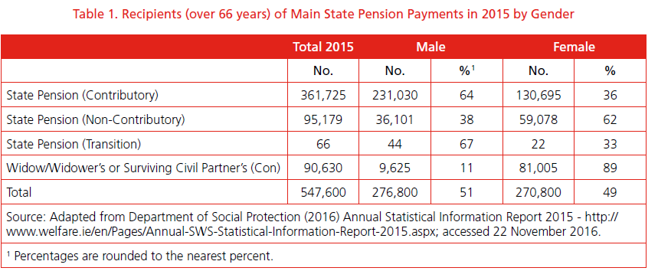
State Pension Payments by Gender 2015

Slide 18
Qualified Adults (2015)
Type of Payment | Total Number of Recipients | Qualified Adults
State Pension (Non Contributory) | 95,179 | 3,207
State Pension (Contributory) | 361,725 | 68,561

Slide 19
Levels of Payments
Lack of data from Department of Social Protection on levels;
Some information in Actuarial Review (2012) of the Social Insurance Fund (SIF);Draws on 2010 data so predates band changes in 2012;
Just over half of all recipients of the SPC were on the full rate;
Another 21 per cent were in second band payment and receiving 98 per cent;
55 per cent of men were on the top rate compared to just under 41 per cent of women.

Slide 20
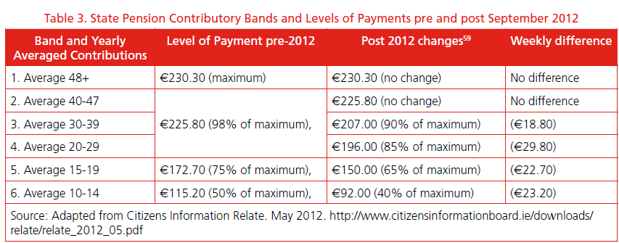
SPC Payment Bands pre and post 2012

Slide 21
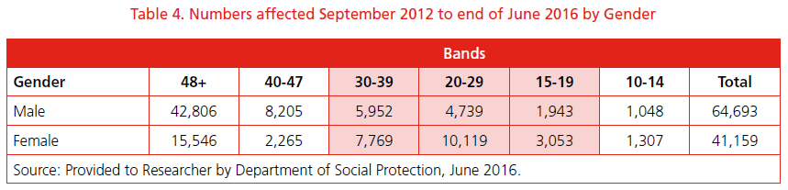
Numbers and Gender Affected by Band Changes (to June 2016)

Slide 22
Analysis of Number and Gender Affected (1)
People affected are those in bands three, four, five and six;
Significant number of people-almost 36,000 (and rising)-have lower pensions;
Both men and women are affected but gendered nature of the impact is significant;
Women are almost twice as likely to be affected as men;
They make up 62 per cent of those who are receiving a lower pension.

Slide 23
Analysis of Number and Gender Affected (2)
Other key findings from the data include:
38 per cent of all women got a full pension compared to 66 per cent of men;
More than double the number of women to men fell into band four; people in this band experience the largest reduction in monetary terms at almost €30 per week;
Almost 25 per cent (10,119) of all women who were granted a State Pension Contributory fell into band four compared to just over seven per cent (4,739) of men;
11 per cent of all women fall into bands five and six compared to under five per cent of men.

Slide 24
Official Rationale for Changes
To make savings-different estimates for level of these (during research DSP official indicated approximately10 million euro per year but says needs more research);
To closer align level of payments with level of contributions;
To ensure sustainability of State Pension System;
Changes made in context of Government insistence that no cut to core payments;
Changes not emphasised in main budget speeches–‘kept under the radar’.

Slide 25
Prior Knowledge of Unequal Impact of Changes on Women
Analysis of a comprehensive sample of PRSI contributions records carried out by the Department of Social Protection in 2011;
Details released by the department to journalist Conor Ryan of the Irish Examiner -under Freedom of Information;
His article highlights that a gender disparity was clear in this analysis:
  ‘that documents show that the impact on the lower categories, where there was mostly women, was flagged by officials in October 2011’ ( Ryan, C. 2014). http://www.irishexaminer.com/viewpoints/analysis/no-country-for-old-women-as-females-bear-brunt-of-pension-cuts-262241.html

Slide 26
Fit with Equality and Rights Legislation and other Government Policy?
This raises the question of whether the band changes are in contravention of Irish, EU and UN equality and human rights conventions and legislation. This needs further investigation by bodies charged with their oversight
Also how do they fit with Government commitments under the National Women’s Strategy (2007-2016) including objectives and commitments regarding pension income?

Slide 27
Discrimination on Age and Gender Grounds
The Department of Social Protection as a public body has a duty to eliminate discrimination and protect the human rights of those to whom it provides services.
It could be argued that the introduction of the new bands discriminates against all those
affected, as they now receive a lower payment than people with similar averaged contributions who retired before September 2012 the majority of whom are women.

Slide 28
Case Studies

Slide 29
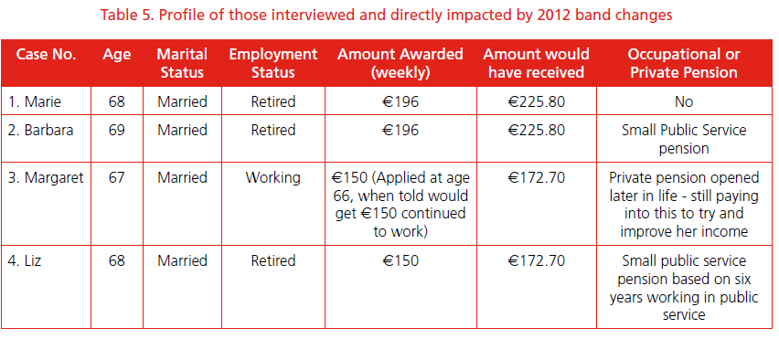
Those Directly Impacted

Slide 30
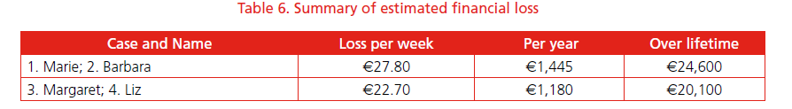
Estimated Economic Loss over Life Span

Slide 31
Main Reasons for Reduced Payments
Forced to leave employment due to State marriage bar (1);
Caring for children during 70’s and 80’s when little or no child care provided and when culturally expected;
Caring for a child with intellectual disability or parents with poor health again when little or no services offered;
Averaging method going back to age 16 if in employment (with PRSI contributions); even if followed by extended period out of the workforce for family care reasons:
Lack of access to Homemaker’s Scheme-only applies to care role from April 1994:
Lack of prior notice.

Slide 32
Impacts on those affected
The interviews with women directly affected revealed that they:
Are left with a deep sense of injustice;
Feel undervalued and angry :
Believe are being penalised for doing what was expected of them, that is, care for their children (those with children 4 of 5 interviewed ).
The significant financial losses are resulting in economic impacts including:
Constantly watching what is spent:
Cutting back on both essential and discretionary items:
Feeling more economically dependent on husbands with a sense of reduced autonomy.
Changes introduced in an underhand and ‘sneaky’ way;
Changes creating anxiety and uncertainly about the future amongst people not yet retired- little sense of what their pension payment will be in the future;
Men with atypical labour force participation also impacted.

Slide 33
Views of other Stakeholders (1)
Irish State Pension System-sustainability and need for reform
Priorities? Reform of pillar one and/or pillars two and three;
Some concerned with over emphasis on latter pillars and move to privitisation and individualisation of risk.
Economic Crisis and Rationale for Changes
Austerity approach-insufficient attention to equality and impacts on certain groups;
Changes result in reduced payments-official argument re ‘protection of core payments’ not tenable;
Low levels of social investment-addiction to low taxes;
Inequality in benefits from pension related tax incentives
Tax incentives poor use of state resources-not achieving goal.

Slide 34
Reform -Which Pillars?
There is an urgent need to reform the second and third pillars. A key element of this is the development of a universal supplementary pension system in which the State will have to play a role (Dr David Begg).
There is a need to repair the gaps and anomalies in the first pillar and to address the inequality being experienced by women before addressing issues in pillar two and three and before developing a universal supplementary pension (Senator Alice Mary Higgins).

Slide 35
Adequate Incomes and Social investment
Have to balance economic rationale with the need to ensure that people have an adequate income and a decent standard of living ….which is the main purpose of State Pension policy (Professor Alan Barrett).
Needs to be informed by a more holistic view of social investment which includes seeing it as productive and not passive… needs to move away from an addiction with low taxes (Dr David Begg).

Slide 36
Pension Related Tax reliefs
Tax Reliefs for Private Pensions are a poor direction of state resources; they mainly benefit high earners and the industry rather than the majority of older people….they have not achieved the policy goal of encouraging more people to invest in pensions. CSO figures show a drop in the numbers of people with private or occupational pensions (Senator Alice Mary Higgins).

Slide 37
Views of other Stakeholders (2)
Manner of Introduction
Below the radar and lack of prior notice.
Unequal Gender Impacts
Continuation and embedding unequal treatment of women in the social welfare system, for example, cut off year in Homemakers Scheme;
Lack of valuing and recognition of care role;
Reluctance to address legacy issues relating to older state policies such as the ‘marriage bar’.

Slide 38
Addressing Women’s inequality in State Pension System
There is a need for a modern system of care credits (Senator Alice Mary Higgins).
Investment and support for caring has to be viewed as productive (Dr David Begg).
Targeted interventions now such as backdating the Homemakers’ Scheme could address the inequality for many of the women who are now retiring (Dr David Begg).
It is critical that there is coordination between different policies and across government departments to tackle the embedded nature of women’s inequality including in the State Pension system (Dr Nata Duvvury).

Slide 39
Recommendations- Equality Framework
The issues highlighted in this report emphasise the importance of framing the pension reform agenda not only in terms of sustainability but in terms of equality.
The lack of an equality focus when framing the 2012 band changes has resulted in inequality being experienced by a considerable number of older people, the majority of whom are women. This further embeds women’s inequality in the system. This report calls for equality to be an overarching framework for all future State Pension policy.

Slide 40
Recommendations (2)
The Minister for Social Protection should:
1. Reverse the band changes and backdate the changes so that those currently affected are placed in the bands which applied before the 2012 change.
2. Backdate the Homemakers’ Scheme to ensure all women retiring from now on and who cared for children will benefit.
3. Insert a modern system of care credits in the development of the Total Contributions Approach. (Conduct and draw on evidence based research to inform this development including investigation of best practice models from other countries).
4. Prioritise reform of pillar one of the State Pension system rather than the current focus on pillars two and three. In this reform ensure gender equality and income adequacy are a priority.
5. Develop data collections systems within the Department of Social Protection including gender disaggregation on the
levels of payments under all State Pension schemes and include the data in Annual Statistical Reports.

Slide 41
Recommendations (3)
The Government should:
6. Implement the commitment in the Programme for Government to carry out and publish impact assessments based on equality principles on all future policy development. Gender proof and equality proof all future budgets and publish evidence of these in budget documents.
7. Develop a cross-departmental comprehensive long-term strategy to address the gender pension gap for current and future generations of women including targets, resourcing, implementation strategy, oversight and reporting and monitoring mechanisms.

Slide 42
Recommendations (4)
It is recommended that the Irish Human Rights and Equality Commission:
8. Considers the findings of this report on the band changes (and the Homemakers’ Scheme) in light of their compliance or otherwise with national and/or international equality and human rights law and conventions.
The Department of Justice and Equality must:
9. Ensure the new (forthcoming) National Women’s Strategy includes objectives and actions to address pension inequalities for women.

